Slide 1






MINI – PROJECT I PRESENTATION

Slide 2

E-AUCTION
Presented By:
Md. Faraaz Siddiqui (191500454)
Venketesh Mishra (191500905)
Shreyash Gupta (191500786)
Yash Agrawal (191500922)
Suyash Sahu (191500834)

Slide 3
Supervised By: -
Dr. Manoj Varshney
Asst. Professor
Department of Computer Engineering & Applications
GLA UNIVERSITY, MATHURA

Slide 4
OUTLINE
About the Project
Objective
Requirements
Snapshots from the website

Slide 5
ABOUT THE PROJECT
E-Auction is an online auction platform where sellers would be able to set up their products for auction and bidders would be able to bid for that product
We will be providing an easy to use user interface where anyone would be able to register and place their product for auction. The bidders in turn would be able to bid for that product.

Slide 6
OBJECTIVE
For Buyers :-
An E-auction provides procurement professionals with competitive prices for
their products, pitching the suppliers directly against each other to see who
can offer the lowest prices. It also streamlines the procurement process and
saves time, since each supplier is not required to submit a full proposal.
For Suppliers :-
E-auctions tend to be open, allowing smaller businesses to compete in the
process, which in turn also enables suppliers to compete in new sectors. A
winning bid can lead to more business, as most buyers will look to source their
‘non-core’ products from their existing supplier.

Slide 7
REQUIREMENTS
Software Specification Used:-
Technology Implemented : Firebase by Google
Language Used : HTML, CSS, JavaScript, Bootstrap
Development Environment : Visual Studio code
Web Browser : Chrome / Firefox / Microsoft Edge

Slide 8
Hardware Used:
Processor Used: Pentium 4 or above
Operating System: Windows 7 or above
RAM: 2 GB or above
Hardware Devices: Computer System
Hard Disk: 10 GB or above

Slide 9
THIS IS HOW OUR WEBSITE LOOKS
Hope you will like it :)

Slide 10
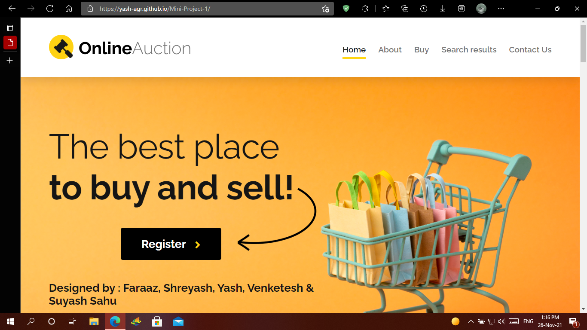
Home PAGE

Slide 11
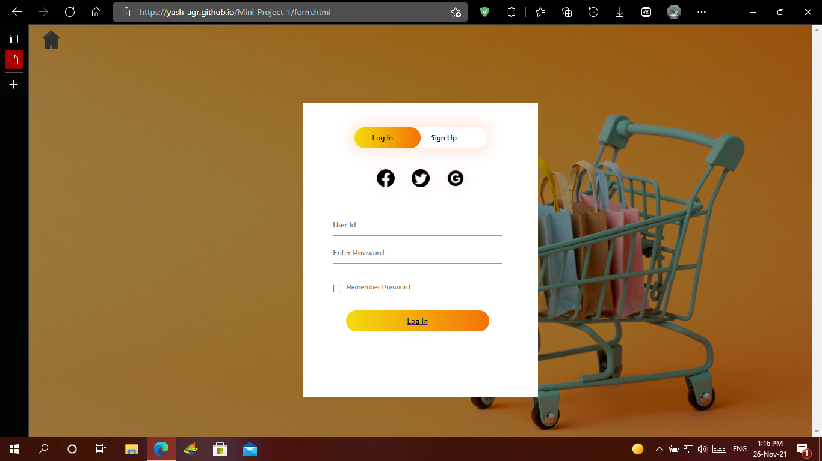
2. Login/Register PAGE

Slide 12
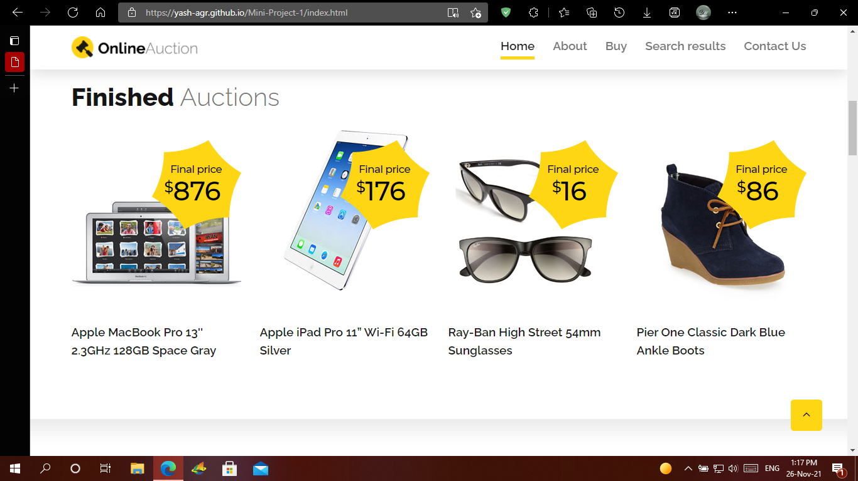
3. Finished Auction Page

Slide 13
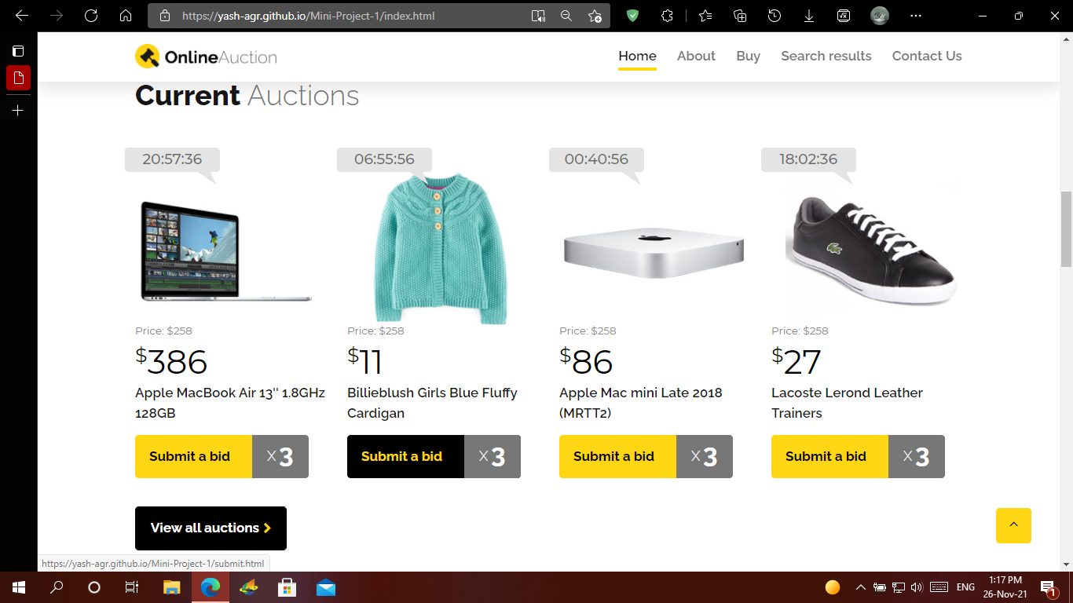
4. Current Auction Page

Slide 14
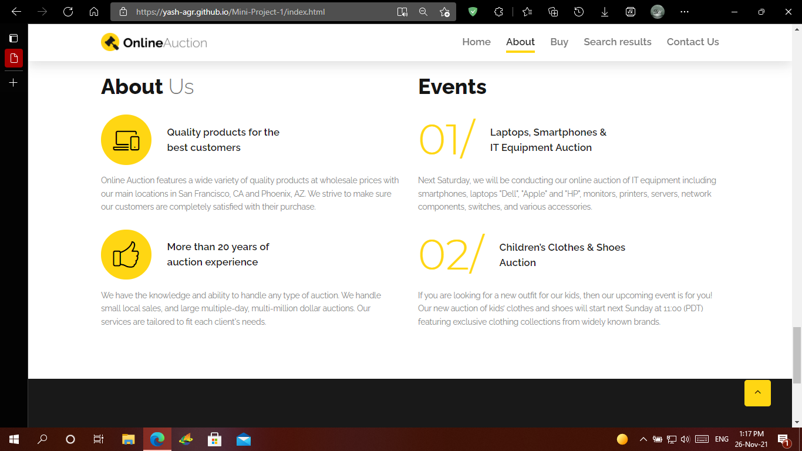
5. AboutUs PAGE

Slide 15
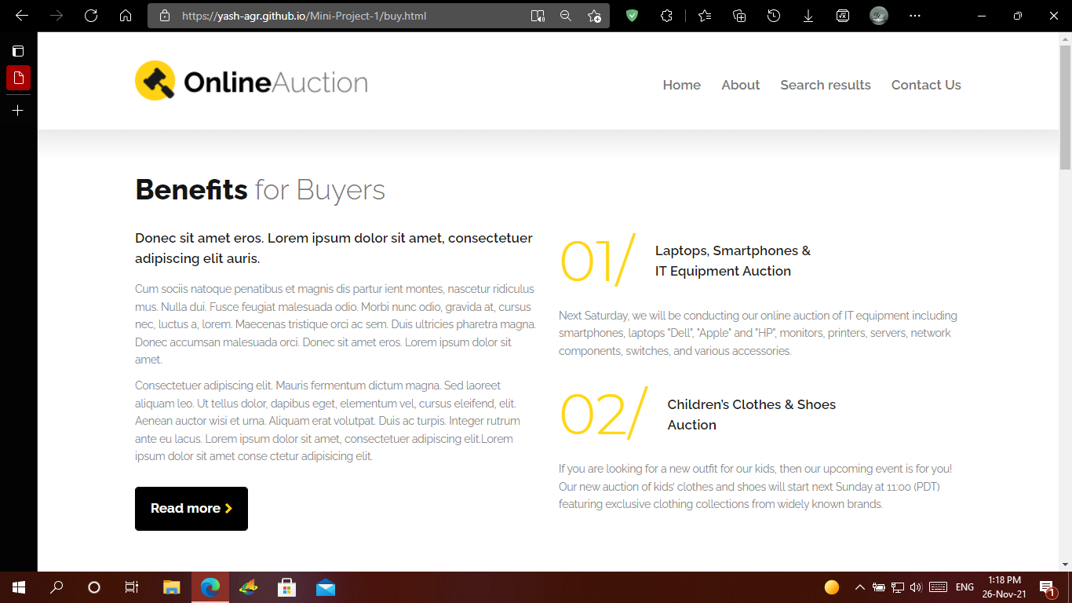
6. Buy PAGE

Slide 16
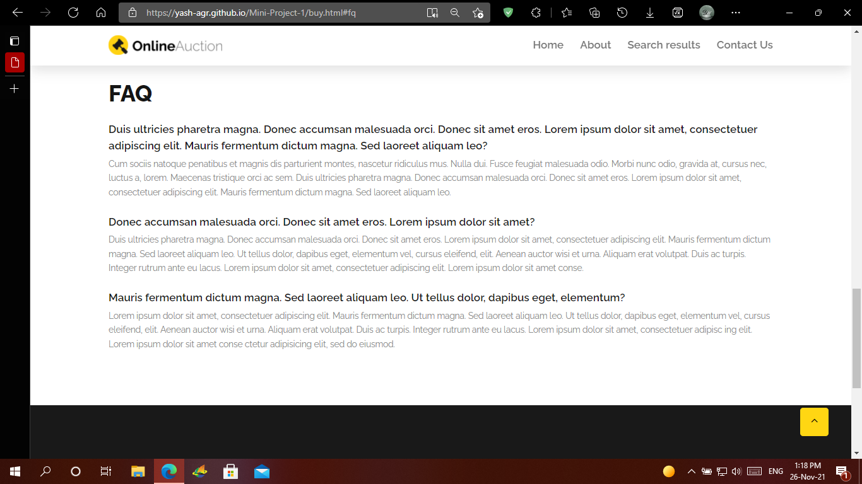
7. FAQ PAGE

Slide 17
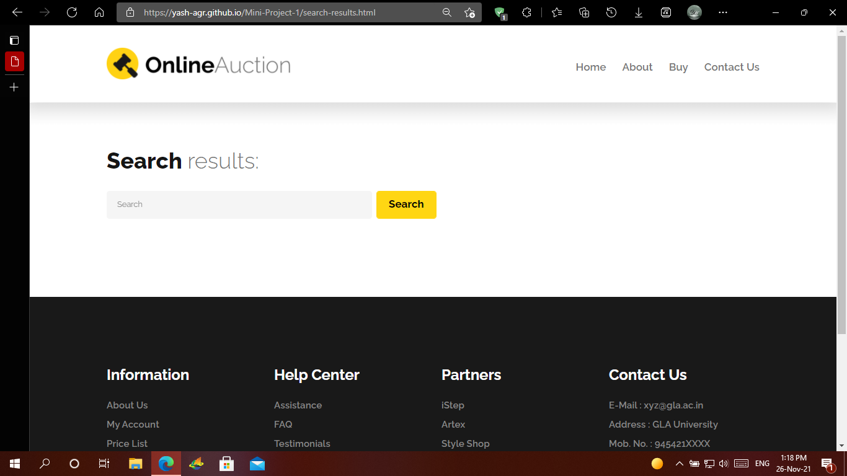
8. Search PAGE

Slide 18
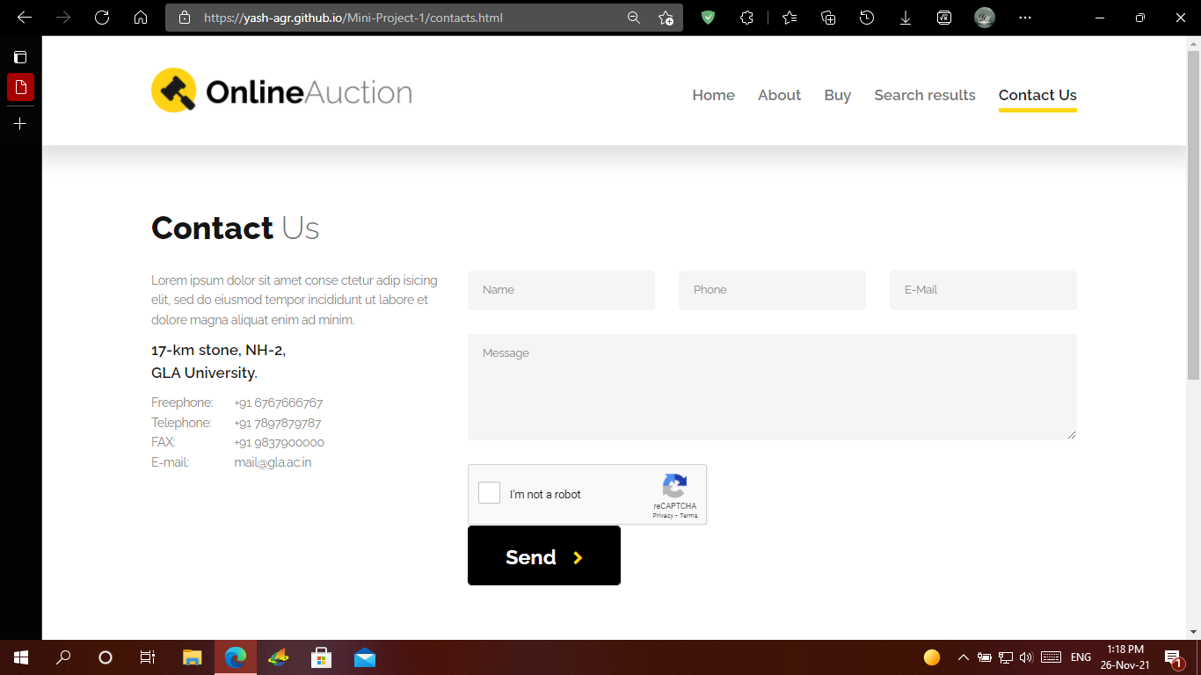
9. Contact Us Page

Slide 19
Future Scope
E-Auction provides an opportunity for the seller to bring forward services and products to millions of buyers from across the world.
It provides feasibility to user to sell or purchase product without going to auction house.
E-Auction provides more crystal clear service of buying and selling products by trying to eliminate most of the auction frauds.
It brings different types of sellers and collectors acrosss the world on one platform, which attracts more buyers.

Slide 20
Thank You!!!

